Slide 1









English Year 6
Unit 1- It's an Emergency!

Slide 2





Welcome, Students!

Slide 3











By the end of the lesson, pupils will be able to:
Guess the meaning of unfamiliar words from clues provided by other known words and by context.
Understand specific information and details of simple longer texts.
Understand with little or no support, specific information and details of longer simple texts on a range of familiar topics.
Understand with little or no support, the main idea of longer simple texts on a range of familiar topics.
Learning Objectives

Slide 4








Today, we are going to discuss the types of emergencies one could face. We are also going to learn how to describe certain scenarios using simple past & past continuous tenses.
Today's Discussion

Slide 5

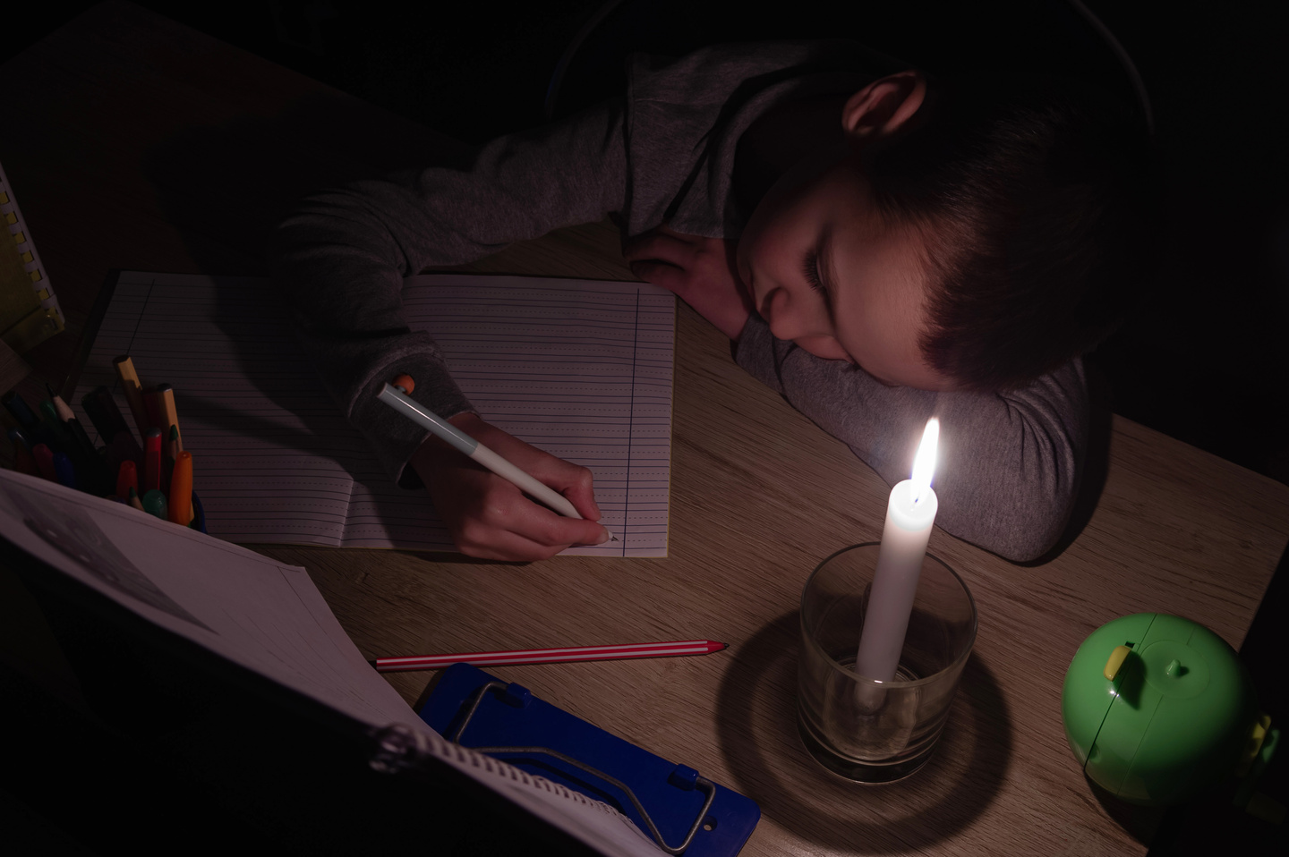
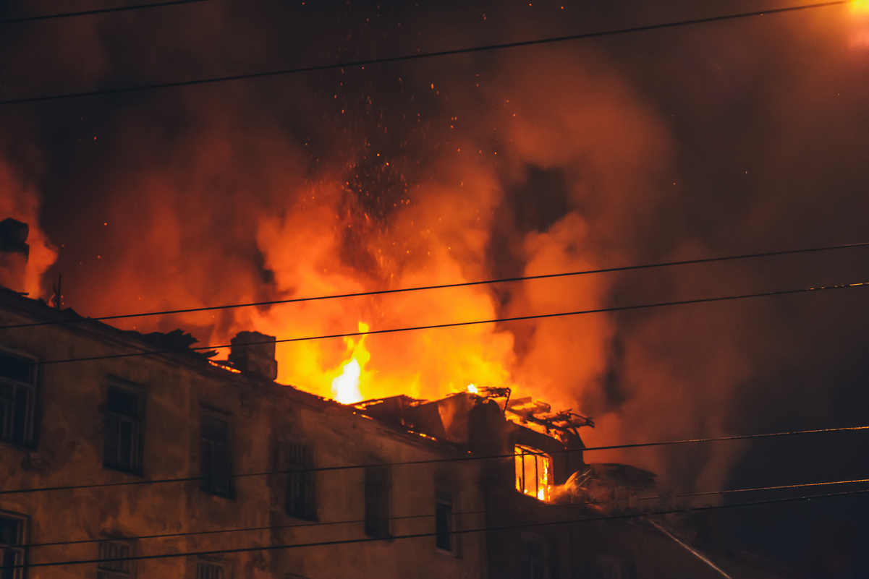


Can You Share Your Thoughts?

Slide 6



Simple Past
& Past Continuous
The simple past tense is used to talk about completed actions in the past.
It is used to describe events that happened at a specific time in the past.
Examples:
The fire alarm rang loudly.
The ambulance arrived quickly.
She called for help.
The past continuous tense is used to talk about ongoing actions in the past.
It describes actions that were happening at a specific time in the past.
Examples:
The firefighters were extinguishing the flames.
One of the paramedics was treating the injured.
People were evacuating the building.

Slide 7





Emergency Situations
In emergency situations, we can use both the simple past and past continuous tenses together to provide more details.
Examples:
While the firefighters were extinguishing the flames, people were evacuating the building.
One of the paramedics was treating the injured when the police arrived.

Slide 8

What were you doing when the fire alarm rang?
Practise with these questions and come up with your own responses.
What were the paramedics doing while the police were securing the area?
What happened after everyone evacuated the building?

Slide 9



THANK YOU!

